Slide 1

BODY SIGNALS OF SMOKING
Team Members
Purvi Jain
Renganathan Laxmanan
Sai Charith Govardhanam
Ore Asaba

Slide 2
ABOUT SMOKING
Tobacco smoking is one of the most important public health problems throughout the world.
Cigarette smoking causes more than 480,000 deaths each year in the United States. This is nearly one in five deaths.
The risk of dying from cigarette smoking has increased over the last 50 years in the U.S.
There are several body signals like age, height, hemoglobin, cholesterol etc. which are
dependent on smoking.
We will be learning more about this in our project.

Slide 3
ABOUT THE DATASET
This dataset contains different body signals of smoking, it has been taken from the Kaggle website.
The dataset has 55,693 observations with 26 variables.
Gender | Age | Height | Weight | Waist | Eyesight (left) | Eyesight (right)
Hearing (left) | Hearing (right) | Systolic | Relaxation | Fasting Blood Sugar | Cholesterol | Triglyceride
HDL | LDL | Hemoglobin | Urine Protein | Serum Cretinine | AST | ALT
GTP | Oral | Dental Caries | Tartar | Smoking

Slide 4
DATA PRE-PROCESSING
Checking for NA's ​
Outlier Detection ​
Subsetting the dataset for analysis

Slide 5
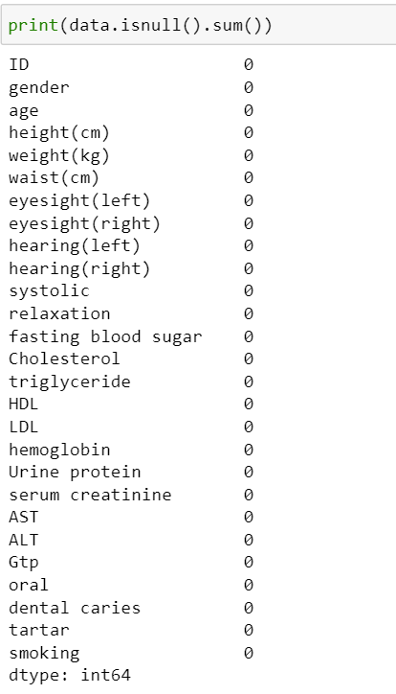
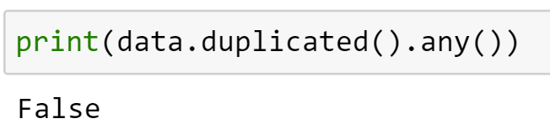
SUMMARY OF THE DATASET
The `isnull().sum()` summarizes the dataset with the missing values if any present.
If we see the output, we can see that the dataset is clean, and no missing values are present and there are no duplicate values as well.

Slide 6
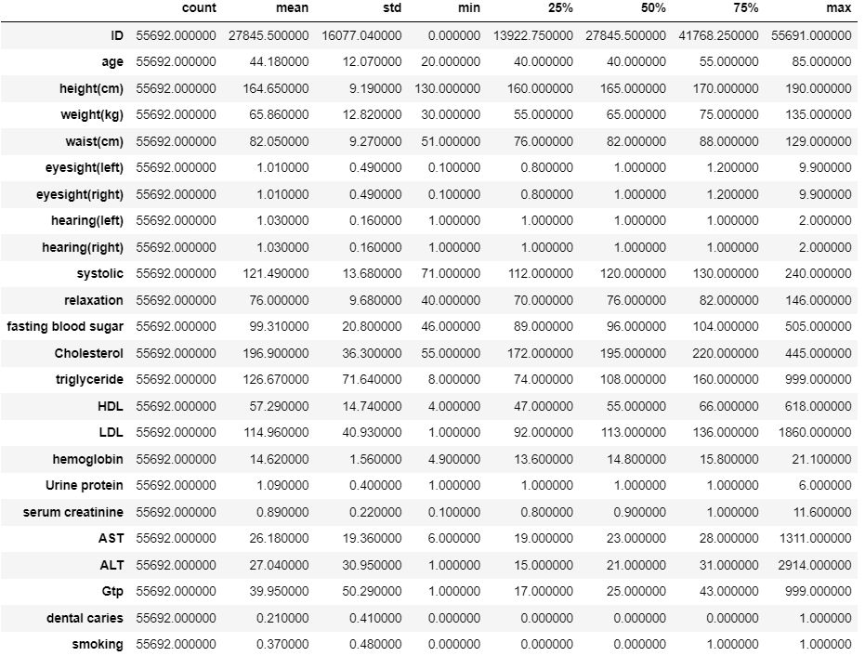
SUMMARY OF THE DATASET

Slide 7
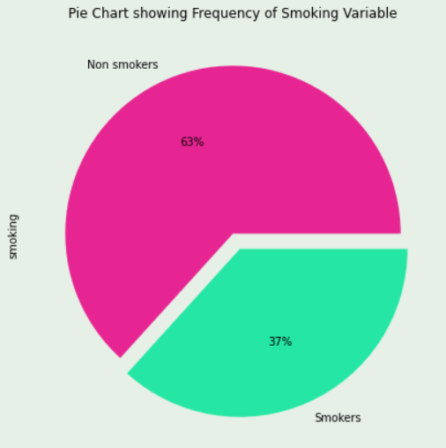
DISTRIBUTION OF THE TARGET VARIABLE

Slide 8
EXPLORATORY DATA ANALYSIS

Slide 9
SMART QUESTION: What are the main factors that show the presence of smoking?

Slide 10
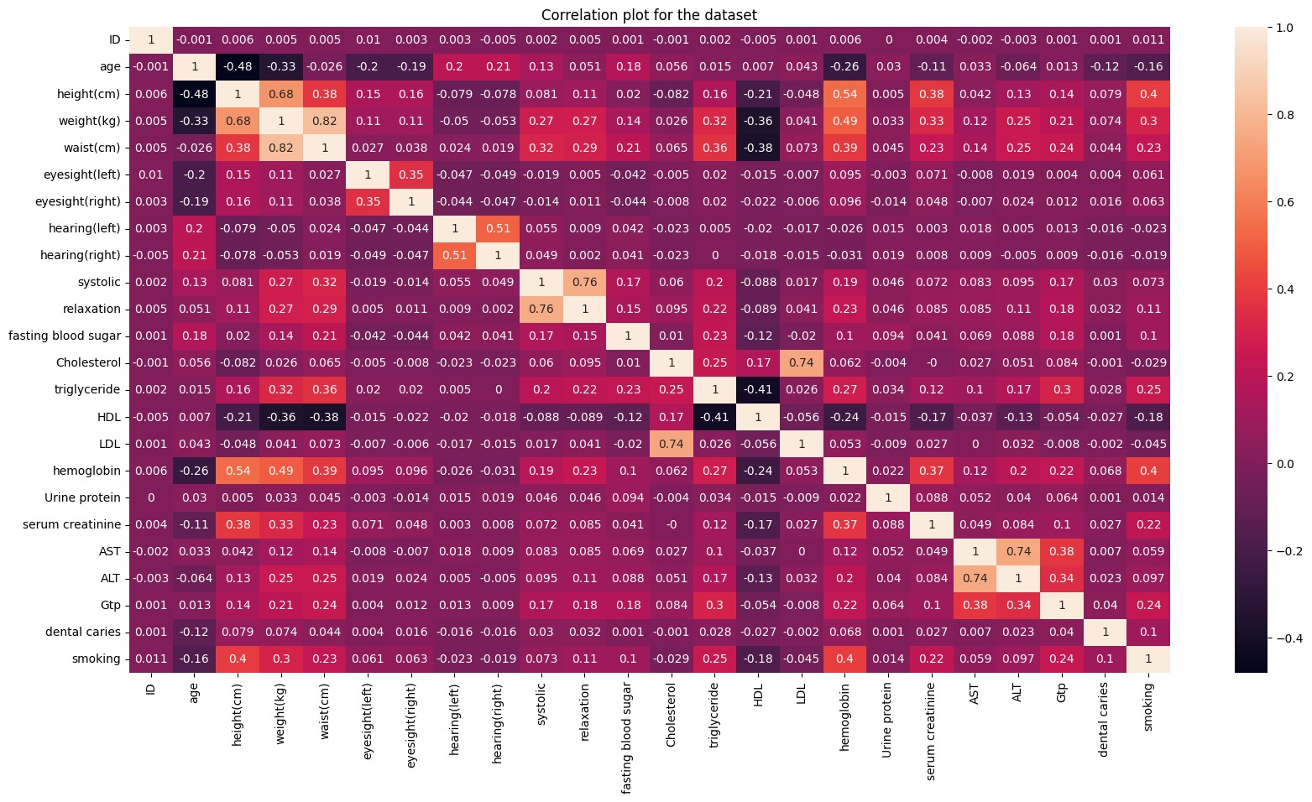
CORRELATION PLOT

Slide 11
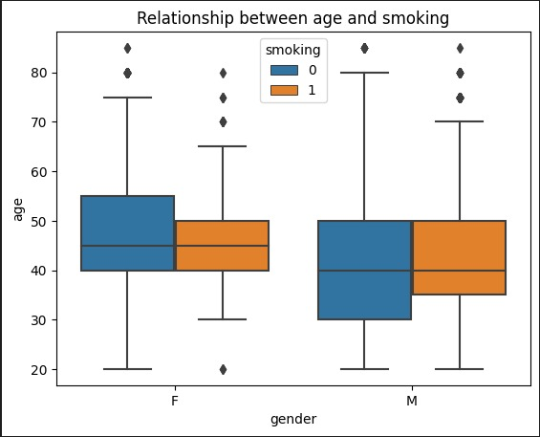
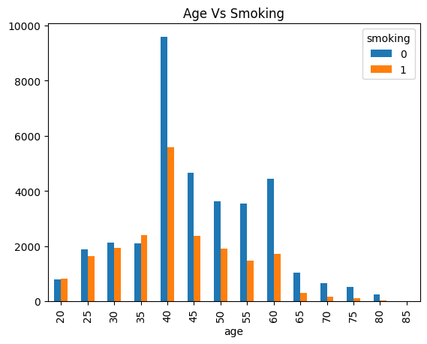
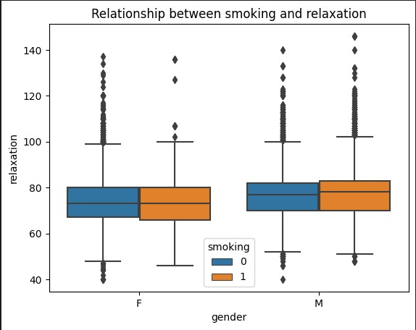
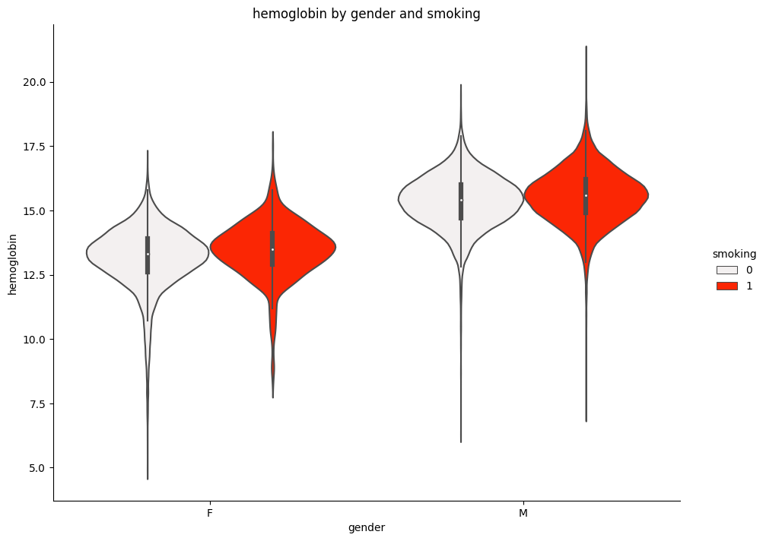

Slide 12
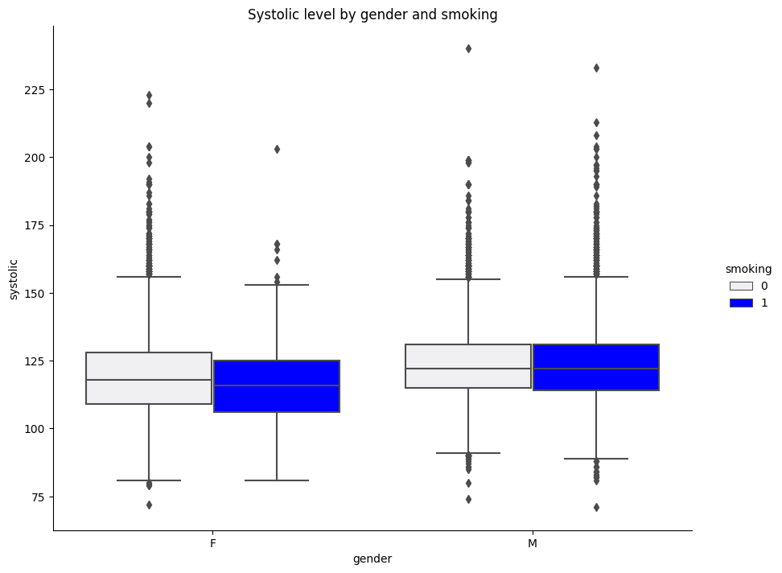
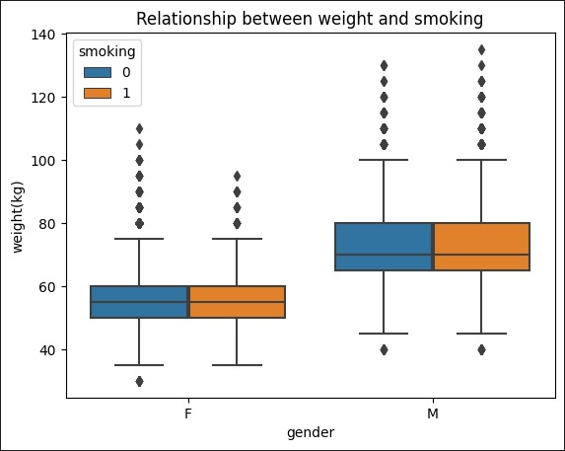
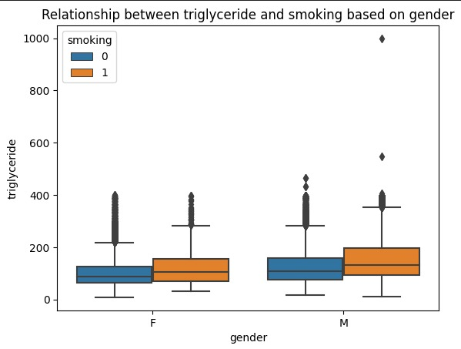

Slide 13
SMART QESTION: HOW TO ADDRESS THE DATA IMBALANCE ISSUE IN THE DATASET?​
Balancing Technique used:​
SMOTE-NC​
​
SMOTE is a technique based on nearest neighbors judged by Euclidean Distance between data points in feature space.
We used the imbalanced-learn library's Synthetic Minority Over-sampling Technique for Nominal and Continuous features (SMOTE-NC), which generates synthetic data for categorical and quantitative features in the data set.
SMOTE-NC modifies the way a new sample is generated slightly by performing something particular for categorical features.
In essence, the categories of a newly created sample are determined by selecting the most frequent category among the nearest neighbors present .

Slide 14
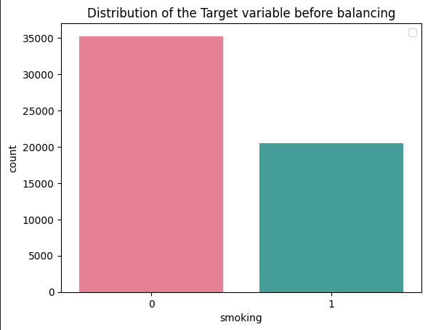
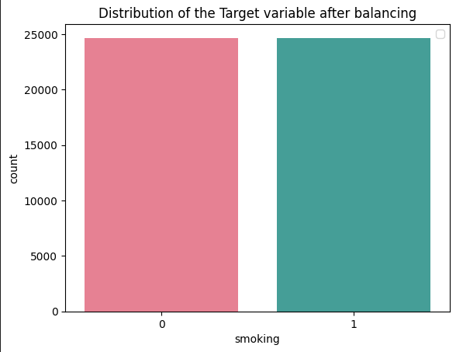
DATA BALANCING

Slide 15
MODEL BUILDING

Slide 16
MODEL TECHNIQUES USED
Logistic Regression ​
Decision Tree Classifier​
Random Forest Classifier ​​
Random Forest Classifier (With Feature Selection)
Random Forest Classifier (With Scaled Values Using MINMAXSCALER)
K-Nearest Neighbor Classification

Slide 17
SMART QUESTION: WHAT EVALUATION METRICS CAN BE USED TO FIND THE BEST MODEL AND WHY?
Evaluation Metrics
Metrics to be considered:
True Negative (TN) | The person does not smoke and the model classified it as a non-smoker.
True Positive (TP) | The person smokes and the model classifies it as a smoker.
False Positive (FP) | The person does not smoke and the model classified it as a smoker.
False Negative (FN) | The person smokes and the model classifies it as a non-smoker.
Accuracy , AUC-ROC Curve, and F-1 score is considered for metrics.

Slide 18
WHY ACCURACY AND AUC-ROC CURVE?​
Accuracy is given more preference in this case because, in this case we need to find the person who smokes based on their body signal, and hence we need the model to clearly classify the two classes and predict accordingly and hence accuracy and AUC-ROC curve are chosen.

Slide 19
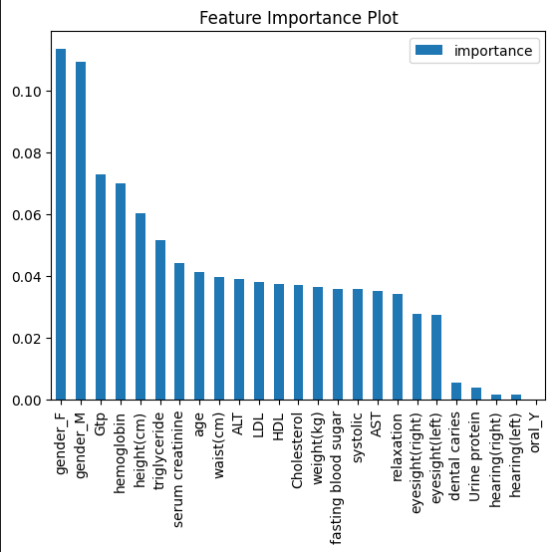
FEATURE SELECTION USING RANDOM FOREST CLASSIFIER
Random forests are made up of 4 to 12 hundred decision trees, each of which is constructed using a random extraction of observations from the dataset and a random extraction of features.​
Each tree is also a sequence of yes-no questions based on a single or combination of features.​
Not every tree sees all the features or all the observations, and this guarantees that the trees are de-correlated and therefore less prone to over-fitting.​
At each node, the tree divides the dataset into 2 buckets, each of them hosting observations that are more similar among themselves and different from the ones in the other bucket. Therefore, the importance of each feature is derived from how “pure” each of the buckets is.

Slide 20
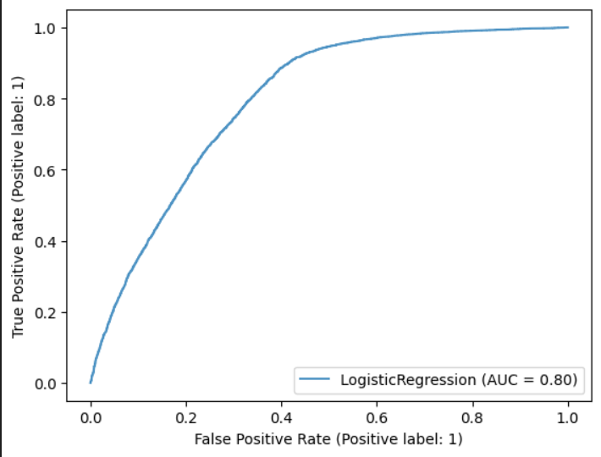
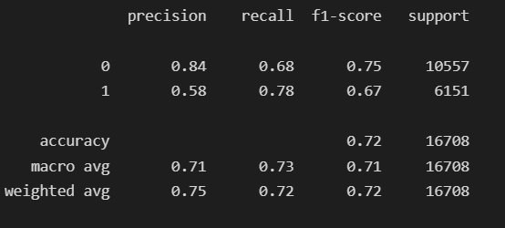
LOGISTIC REGRESSION MODEL
Logistic regression is often used for classification and predictive analytics.
Logistic regression estimates the probability of an event occurring, such as smoker or a non-smoker, based on the given dataset of independent variables.

Slide 21
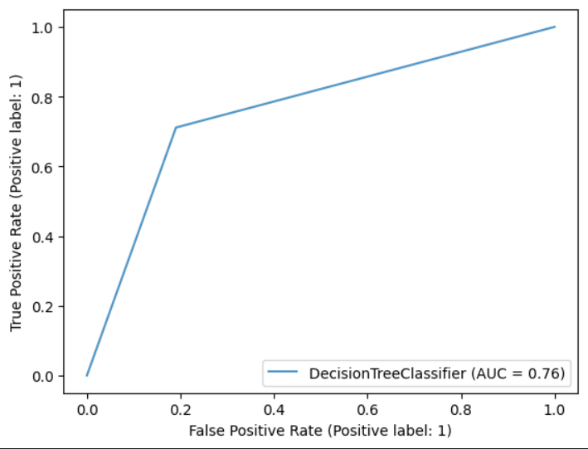
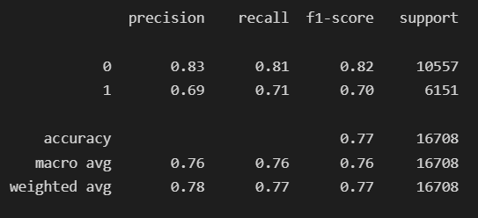
DECISION TREE MODEL
Decision tree models are mostly used to develop classification systems that predict or classify future observations based on a set of decision rules.
If you have data divided into classes that interest you (for example, smoker vs non-smoker, low risk vs high risk), you can use your data to build rules that you can use to classify old or new cases with maximum accuracy.

Slide 22
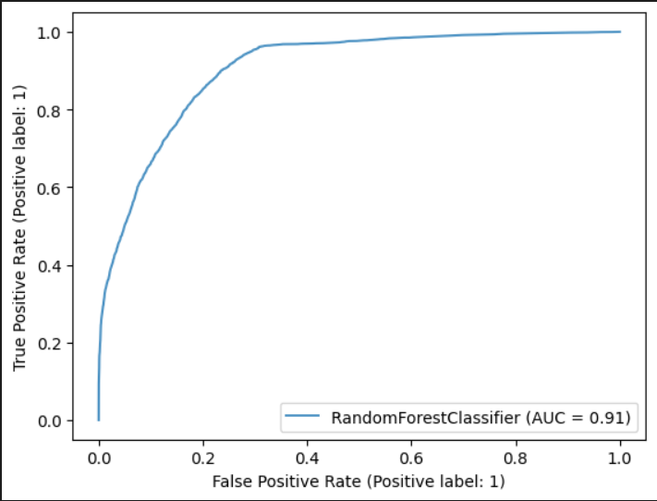
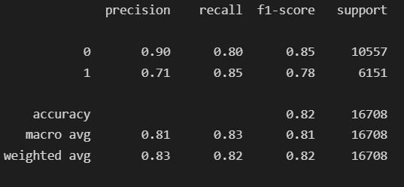
RANDOM FOREST MODEL
Random forest model builds decision trees on different samples and takes their majority vote for classification and average in case of regression.
One of the most important features of the Random Forest Algorithm is that it can handle the data set containing continuous variables as in the case of regression and categorical variables as in the case of classification.

Slide 23
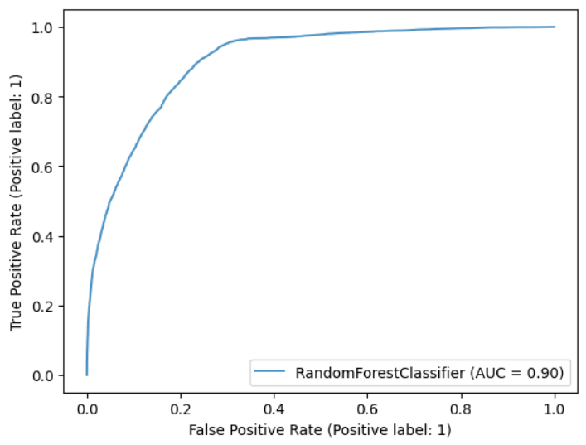
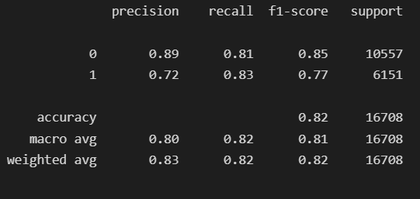
RANDOM FOREST CLASSIFIER MODEL (WITH FEATURE SELECTION)
The features used in this model are:
Gender_F | Gender_M | GTP | Hemoglobin | Height | Triglyceride
Serum Creatinine | Age | Waist | ALT | LDL | HDL

Slide 24

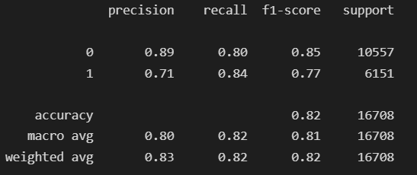
RANDOM FOREST CLASSIFIER MODEL (WITH SCALED VALUES USING MINMAXSCALER)
MinMaxScaler is a method used in machine learning to transform the features of a dataset to a given range, often between 0 and 1. ​
The way it works is by first fitting the scaler to the data, which means it calculates the minimum and maximum values for each feature.
Then, it scales each feature so that its minimum value is 0 and its maximum value is 1.

Slide 25
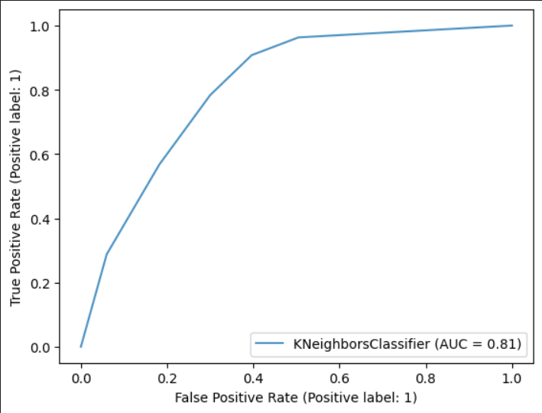
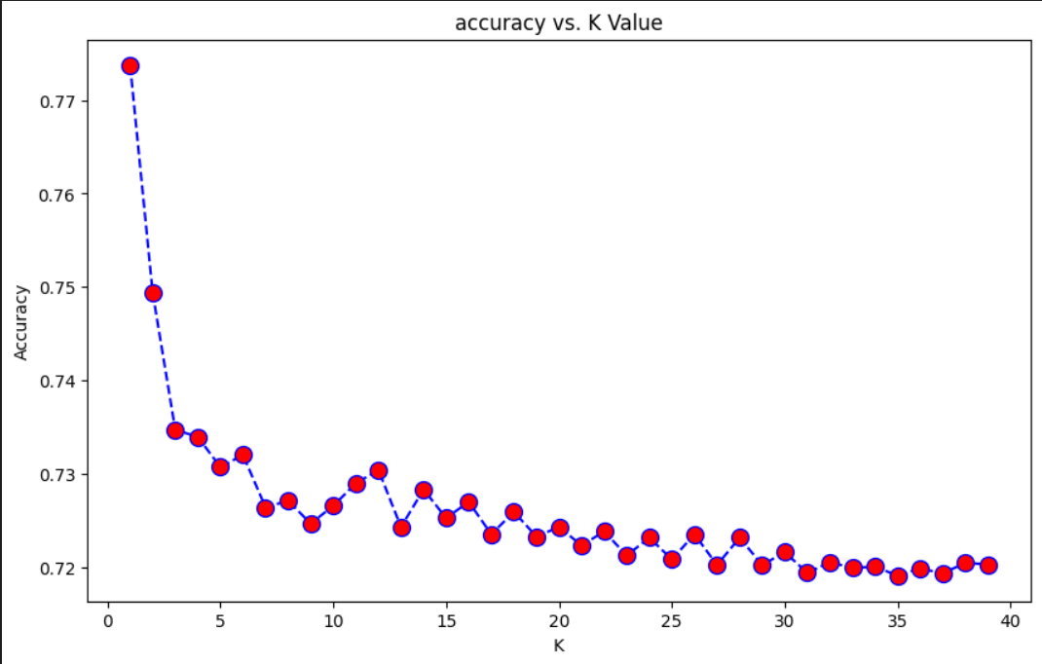
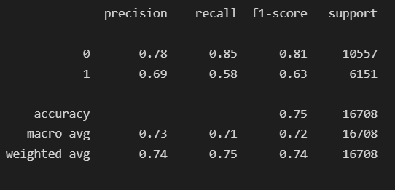
K-NEAREST NEIGHBOR MODEL
The K-nearest neighbors (KNN) algorithm is a data classification method for estimating the likelihood that a data point will become a member of one group or another based on what group the data points nearest to it belong to.

Slide 26
OVERALL MODEL PERFORMANCE COMPARISON​
Models | Accuracy | Precision | Recall | AUC
Logistic Regression | 0.72 | 0.75 | 0.72 | 0.80
Decision Tree | 0.77 | 0.78 | 0.77 | 0.76
Random Forest | 0.82 | 0.83 | 0.82 | 0.91
Random Forest(With Feature Selection) | 0.82 | 0.82 | 0.82 | 0.90
Random Forest(With Scaling) | 0.82 | 0.83 | 0.82 | 0.90
KNN | 0.75 | 0.74 | 0.75 | 0.81

Slide 27
CONCLUSION
A few important features that can predict if a person is smoking or not are gender, Gtp, hemoglobin, height(cm), triglyceride, serum creatinine, age, waist(cm), ALT, LDL, and HDL.​
​
The data imbalance is addressed by using Synthetic Minority Over-sampling Technique for Nominal and Continuous features (SMOTE-NC)​
High Cholestrol, LDL, and HDL from our dataset can be used to predict heart attack. However, it is important to note that making predictions based on bio-signals is a complex task and requires specialized knowledge and expertise in the field of medical science and machine learning.
​
Random Forest Classifier with feature selection has a better performance compared to the other models as it has a better ability to distinguish between classes .

Slide 28
THANK YOU

